Slide 1

Class 2
Meet the teacher
2023

Slide 2

Mrs Smith – Class Teacher
Mrs Stanford/ Mrs VB (Tues) – Teaching Assistants
Mr Udin – PPA Cover (Friday pm)
Mrs Stanford/ Mrs Zeynep – Interventions

Slide 3
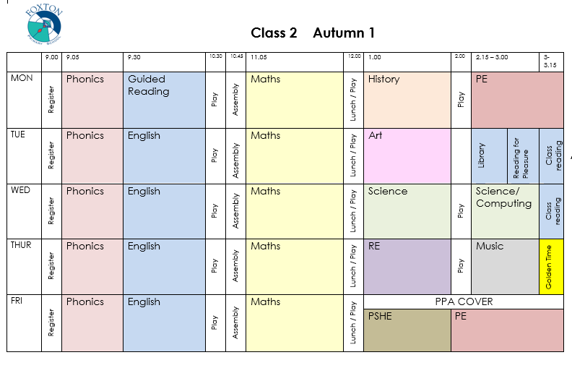

Slide 4

Daily Routine
8.50 – Teachers go onto playground
8.55 – Bell rung and children line up
9.00 – Register taken
9.05 – Morning lessons begin
12.00 – Lunch
1.00 – Afternoon lessons begin
3.15 – Home time!

Slide 5

Morning Lessons
Phonics
English (Mondays - Guided Reading)
Play time
Assembly
Maths
Lunch

Slide 6

Snacks and Lunch
Fruit is provided
Healthy snacks please
Bring a water bottle

Slide 7

Afternoon Lessons
History/Geography and PE
Art / DT and Library session
Science & Computing
RE & Music
PSHE and PE

Slide 8

PE
Monday and Friday afternoons
PE kit is needed in school every day
(white t-shirt, shorts, socks)
Plimsolls or trainers – no laces
No earrings and hair tied back

Slide 9
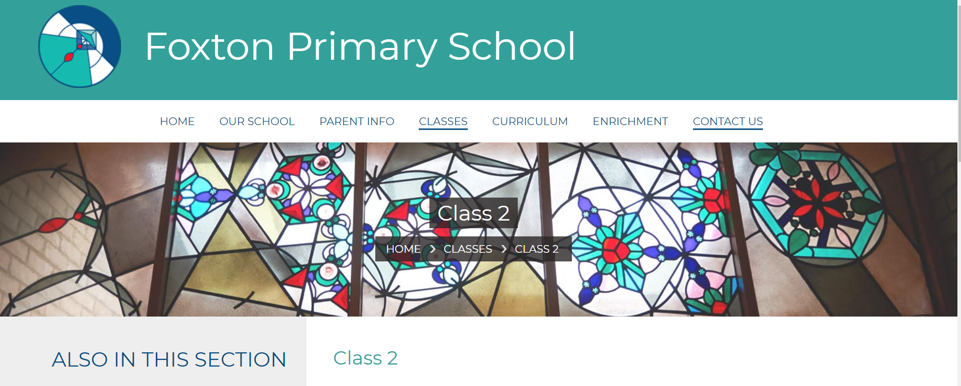
Web page – Class 2
Half termly timetables and topics
Do you follow us on Twitter? @class2foxton

Slide 10

Topics and Extended Homework
London / Great Fire of London
Space / Moon landing
Dinosaurs
Animals
Castles
Seaside

Slide 11

SATS – Year 2
2 x Reading
1 x Spelling
1 x SPaG
2 x Maths

Slide 12

What can you do to help?
Reading – every day!!
Maths – Mathletics
- bonds to 10 / 20
- doubles to 20
- Multiplication 2,5,10 & 3,4
Spellings – Spelling Shed
- Common Exception words

Slide 13
Safeguarding
We aim to ensure that all children feel safe and well cared for at Foxton Primary School. As a school, we follow set guidance in line with ‘Keeping Children Safe in Education’ (KCSIE) and follow our Child Protection and Safeguarding Policy. Our Designated Safeguarding Lead (DSL) is Mrs Muir, along with Mrs Brooks and Ms D’Heudieres who are DDSLs. For more information – please see:
https://www.foxtonprimary.co.uk/page/?title=Safeguarding+Information+for+Parents&pid=319

Slide 14
Keeping children safe online at Foxton
Keeping children safe online is a very important part of our teaching and learning at Foxton. Please follow the link below which leads directly to our website. Here you will find more information about our aims, the four key categories of risk (Content, Contact, Conduct and Commerce), filtering and monitoring and our Online Safety Policy.
https://www.foxtonprimary.co.uk/page/?title=Online+Safety&pid=326
You will also find additional links for parents and families, including guidance and resources to support families about staying safe online, these resources also include short video clips.
https://www.foxtonprimary.co.uk/page/?title=Online+Safety%3A+additional+links+for+parents+and+families&pid=126

Slide 15
County Lines
A term which you may have heard recently is a term called County Lines. This is also a part of the training that all staff have at the beginning of a new academic year, along with Safeguarding and Child Protection. This year, there has been a stronger focus on this as it has become more prominent within schools, especially Secondary Schools.
County lines is a term used to describe gangs and organised criminal networks involved in exporting illegal drugs using dedicated mobile phone lines or other form of “deal line”.
This is a video link, for parents and families which explains more about County Lines.
https://youtu.be/DdYq2dhQ3qc

Slide 16

How is my child getting on?
Parents Evening
Mon 6th & Wed 8th November
Any worries?
Please talk to us.

Slide 17


