Slide 1
Owl Class
Curriculum Meeting
^{24th} September 2025

Slide 2
Mr Marshall – Class teacher
Mrs McDonald – Teaching Assistant
Mrs Rose – Teaching Assistant

Slide 3
Daily routine (Morning)
8.55 – children line up outside and then come into class
9.00 – Register and lunches
9.05 – Guided reading
9.30 – English
10.30 – morning break, Assembly
11.10 – Maths
12.15 – Lunch and Lunch Break

Slide 4
Daily routine (afternoon)
12.45 – lunch break
1.15 – Register
1.20 – afternoon lessons
3.15 – Home

Slide 5
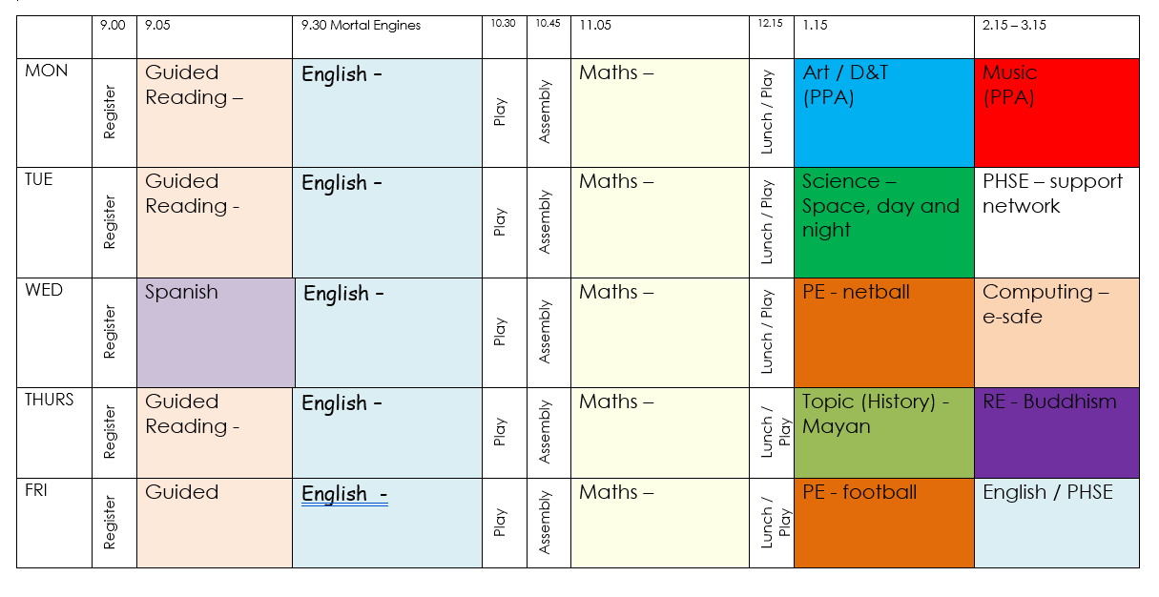
Class timetable
Our weekly timetable can be found on the school website under the Class 4 page.

Slide 6
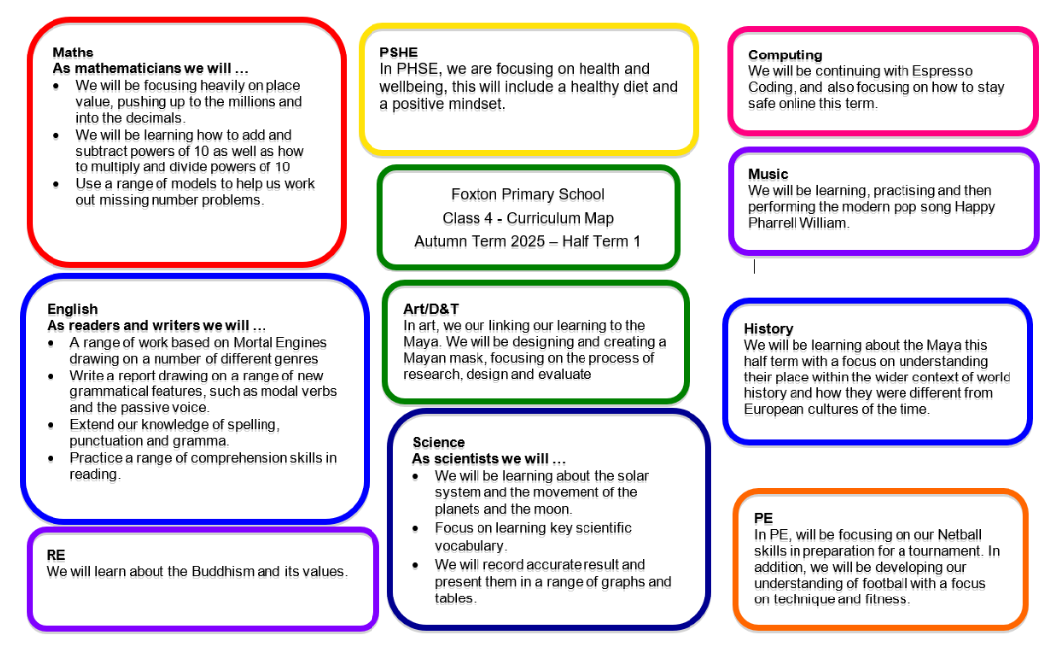
Curriculum overview
This can also be found on our webpage.

Slide 7
PE
Wednesday and Friday
PE kit is needed in school for the week.
No earrings and hair tied back
Sensible footwear and warm clothing is needed

Slide 8
Homework
Mathletics/TTRS & Spelling - set and checked every Friday
Reading 3 plus times a week – Reading records check every Friday

Slide 9
SATs
SATs will take place in the week commencing 11th May 2026.
The tests will take place over four days.
One English reading paper, 3 Maths papers
2 English - spelling, grammar and punctuation papers.

Slide 10

Residential Trip
Hilltop Outdoor Centre, Sheringham
Dates: Monday 22nd – 24th June
Overall cost £299
Depart: 1:30 on the Wednesday
Bring own lunch on day of arrival
Children would need own sleeping bag/bed cover

Slide 11
What can you do at home?
Read as much as possible
Use Mathletics/TTRS/Spelling Shed
Practice times tables – times table rockstars
Keep in touch

Slide 12
Question Time

