Slide 1
Badger Class
Curriculum Meeting
24th September 2025

Slide 2
Teachers
Mrs Smith – Monday & Tuesday
Mrs Brooks - Wednesday, Thur, Fri
Mrs Vaughan – Teaching Assistant

Slide 3
Daily routine (Morning)
8.55 – children line up outside and then come into class
9.00 – Register and lunches
9.05 – Whole Class Reading (Spanish on Wednesdays)
9.30 – English
10.30 – Morning break, Assembly
11.10 – Maths
12.10 – Lunch and Lunch Break

Slide 4
Daily routine (afternoon)
12.30 – lunch break
1.10 – Afternoon lessons
3.15 – Home

Slide 5
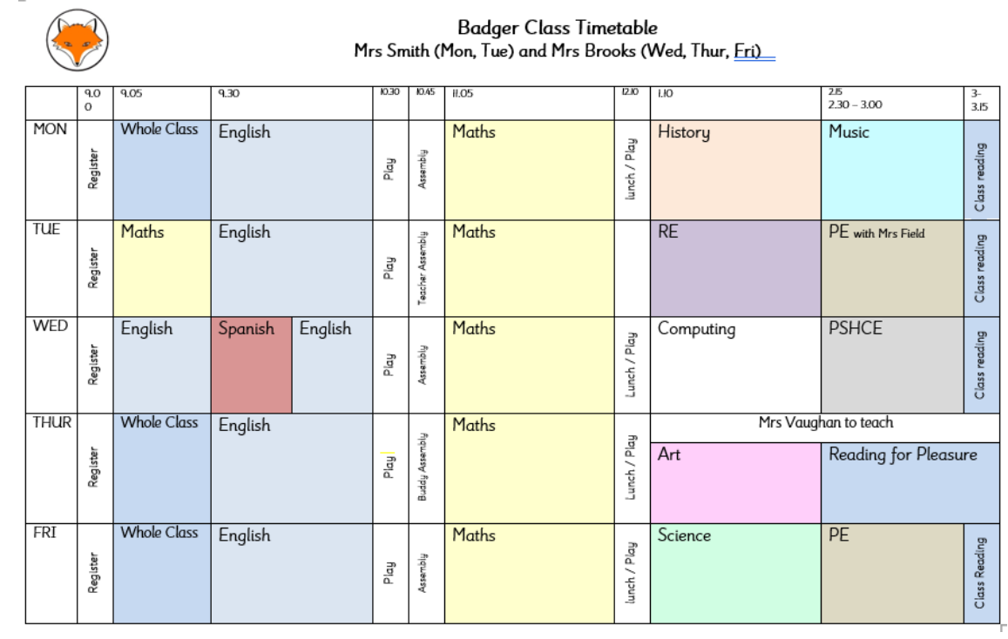
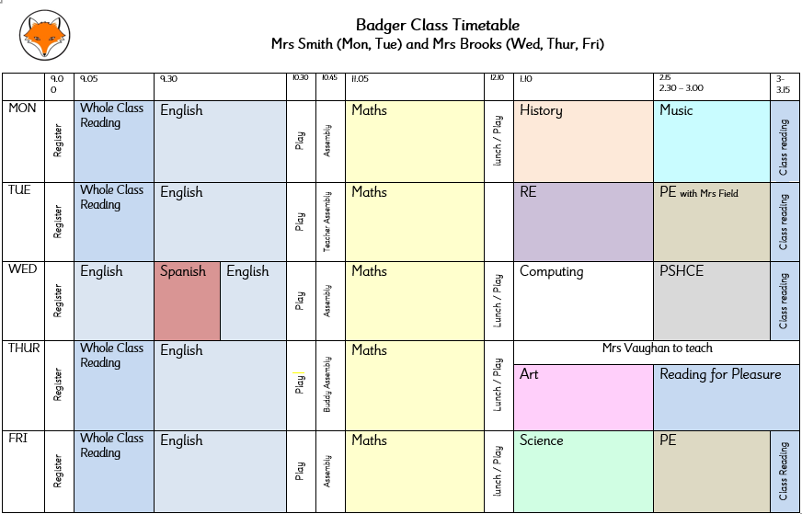
Class timetable
Our weekly timetable can be found on the school website under the Badger Class page.

Slide 7
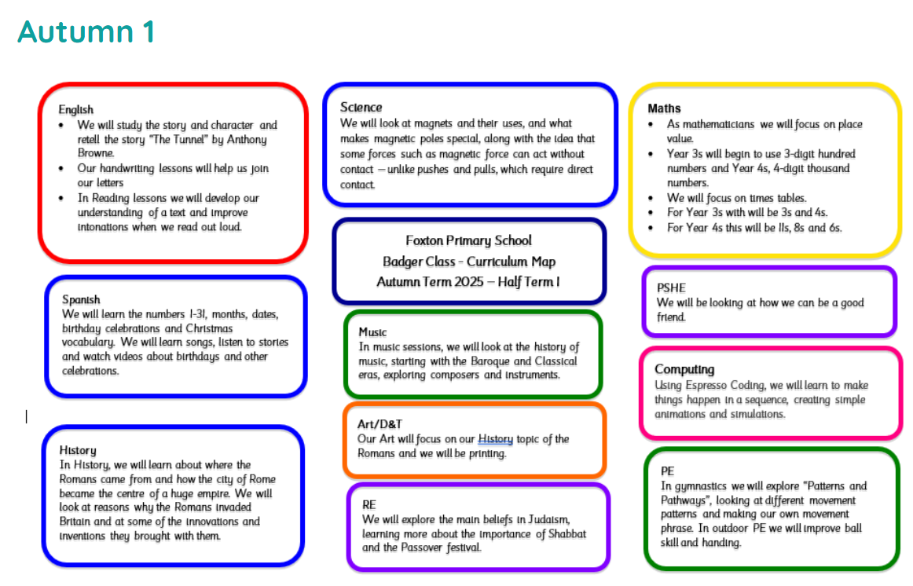
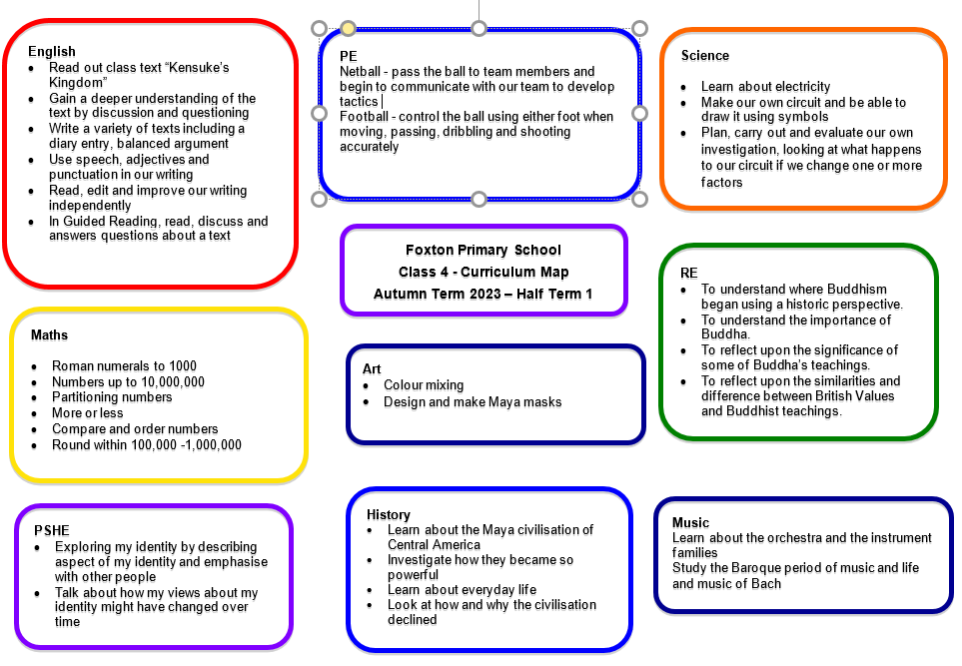
Half termly planning
Can be found on the school website under the Badger Class tab

Slide 8
Topics
History – The Romans, Ancient Egypt, Railways
Geography – Mountains (Italy), River Nile, Royston
Science – magnets, teeth, sound, food, rocks
RE – Judaism, Christmas, Christianity, Easter, Sikhism, Humanism
Computers – Espresso Coding and e-Safety

Slide 9
PE
Tuesday & Friday
PE kit is needed in school for the week.
No earrings and hair tied back
Sports footwear and warm clothing is needed

Slide 10
Homework
EdShed SpellingShed - set and checked every Wednesday
Mathletics – set and checked every Friday
Times Table Rockstars – to practice at home
Reading 3x a week – reading records checked on Friday
Extended homework

Slide 11
Multiplication Tables Check for Year 4s
A short, on-screen digital assessment designed to check Year 4 pupils' ability to recall times tables up to the 12x table.
The test has 25 questions, each displayed for 6 seconds, and takes less than 5 minutes to complete.
June 1st 2026 and is open for 2 weeks

Slide 12
Safeguarding
Safeguarding Lead – Mrs Muir
Deputy Safeguarding Leads – Mrs Brooks & Mrs Huckett (SENCo)

Slide 13
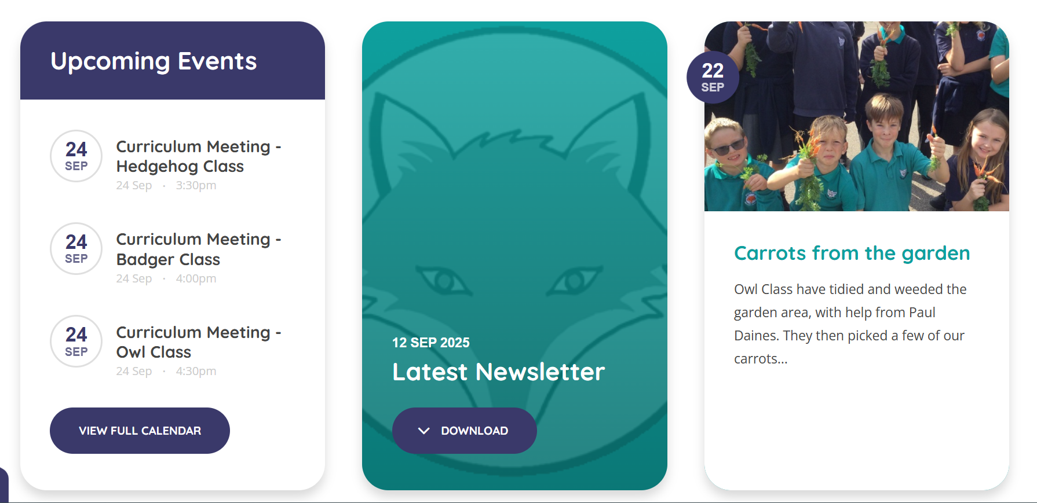
Latest News and Headteacher Newsletter
Latest News and Headteacher Newsletter are a great way for parents to see what activities have taken place or are planned.

Slide 14
What can you do at home?
Read as much as possible with your child
Encourage them to complete Mathletics/Spelling Shed
Practice times tables
Keep in touch

Slide 15
Question Time

