Slide 1
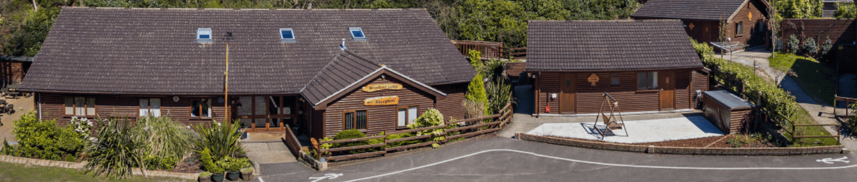
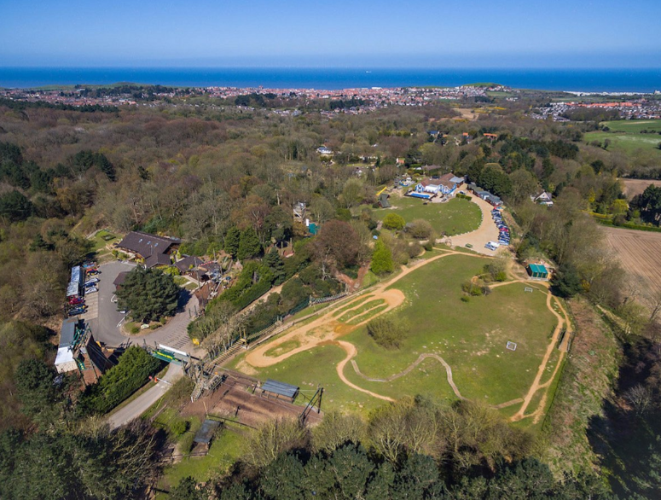
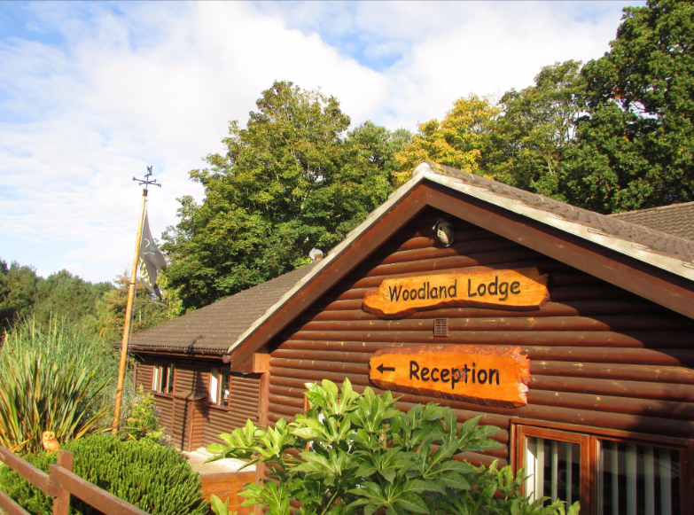
Hilltop 2026 – 22nd 24th June

Slide 2
Activities:
Air jump (2 hours)
Tree top trail (3 hours)
Super Swing (1.5 hours)
Coastal erosion walk (3 hours)
Pond life (1.5 hours)
Woodland life (1.5 hours)
Caving (1.5 hours)
Assault course (1 hour)
Aerial Runway (1.5 hours)
Geography link
Science link

Slide 3
Menu:
One option other than allergies
Pasta Bolognese, salad, garlic bread
Sausages, mash, veg, gravy
Pudding options:
Day 1 – ice cream and sauce
Day 2 – chocolate sponge and custard

Slide 4


Slide 5
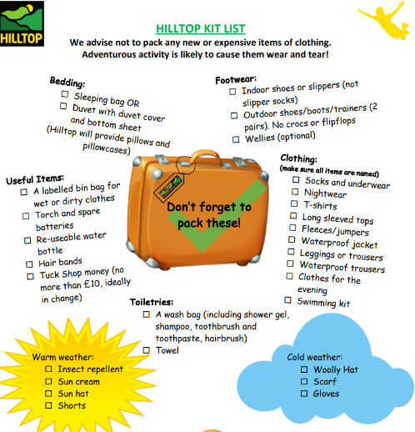

Hilltop 2026– What should they bring?

Slide 6


